Slide 1
Data Structure and Algorithm
Course code: cs-201
Topic: Trees in data structure
Instructor: habiba arshad

Slide 2
Binary Search Tree (BST)
Expression tree
BSt creation
Searching in BST

Slide 3

Preparing a Tree from an infix arithmetic expression
Find operator which has low priority with respect to execution, starting from left to right. Put it on the root and then continue this process on sub-trees. The infix expression on the left side is converted into tree. Examine this tree is a 2-trees, where each node either has two nodes or zero.

Slide 4
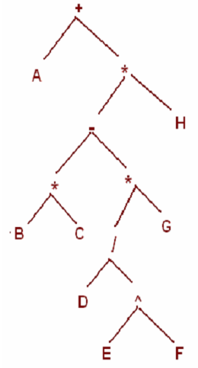



Slide 5
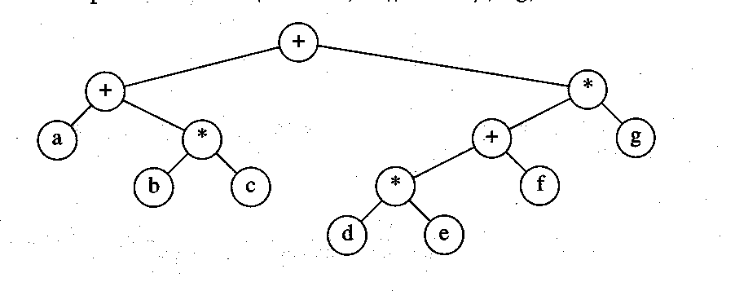
Expression Trees
(a+b*c) +((d*e+f)*g)
Notes:
* / same precedence level, scan from left to right. The operator that will come first that will be evaluated first.

Slide 6
Practice Questions
Create an expression tree for the given expression. Also write the preorder and post order form of the tree.
(A – B ) / (( C * D ) + E )
[ A + ( B – C )] * [( D – E ) / ( F + G – H )]

Slide 7
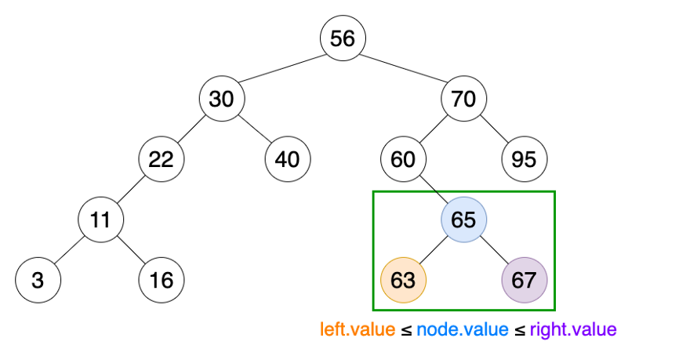
Binary Search Tree (BST)
Binary Search Tree (BST) is an extension of Binary tree with some added constraints.
In BST, the value of the left child of a node must be smaller than or equal to the value of its parent and the value of the right child is always larger than or equal to the value of its parent.
This property of Binary Search Tree makes it suitable for searching operations as at each node we can decide accurately whether the value will be in left subtree or right subtree.
Therefore, it is called a Search Tree.
Notes:
https://www.programiz.com/dsa/trees
https://towardsdatascience.com/8-useful-tree-data-structures-worth-knowing-8532c7231e8c
https://www.thecrazyprogrammer.com/2019/09/types-of-trees-in-data-structure.html

Slide 8
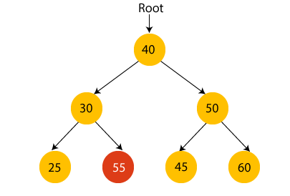
Binary Search Tree (BST)
Suppose if we change the value of node 30 to 55 in the given tree, check whether the tree will be binary search tree or not.
In the given tree, the value of root node is 40, which is greater than its left child 30 but smaller than right child of 30, i.e., 55. So, the above tree does not satisfy the property of Binary search tree. Therefore, this tree is not a binary search tree.

Slide 9
Advantages of BST
Searching an element in the Binary search tree is easy as we always have a hint that which subtree has the desired element.
As compared to array and linked lists, insertion and deletion operations are faster in BST.

Slide 10
Basic Operations on BST
Following are the basic operations of a tree −
Search − Searches an element in a tree.
Insert − Inserts an element in a tree.
Pre-order Traversal − Traverses a tree in a pre-order manner.
In-order Traversal − Traverses a tree in an in-order manner.
Post-order Traversal − Traverses a tree in a post-order manner.

Slide 11
Creation of BST
Let us take nine numbers and insert them in binary tree which is initially empty.
Suppose the data elements are - 45, 15, 79, 90, 10, 55, 12, 20, 50.
First, we have to insert 45 into the tree as the root of the tree.
Then, read the next element; if it is smaller than the root node, insert it as the root of the left subtree, and move to the next element.
Otherwise, if the element is larger than the root node, then insert it as the root of the right subtree.

Slide 12

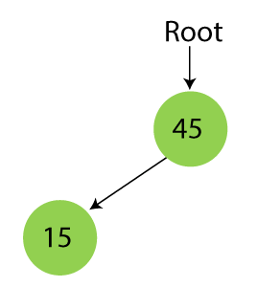
Steps to Create BST
Step 1 - Insert 45.
Step 2 - Insert 15.
As 15 is smaller than 45, so insert it as the root node of the left subtree.

Slide 13
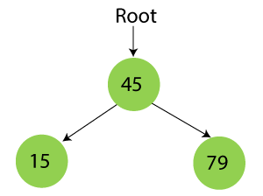
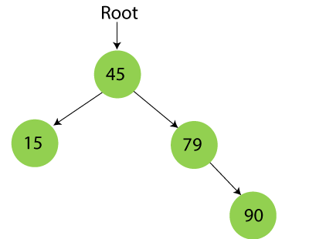
Steps to Create BST
Step 3 - Insert 79.
As 79 is greater than 45, so insert it as the root node of the right subtree.
Step 4 - Insert 90.
90 is greater than 45 and 79, so it will be inserted as the right subtree of 79.

Slide 14
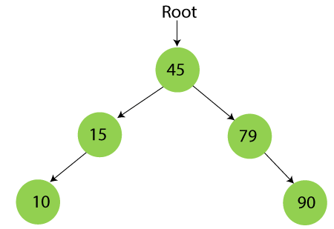
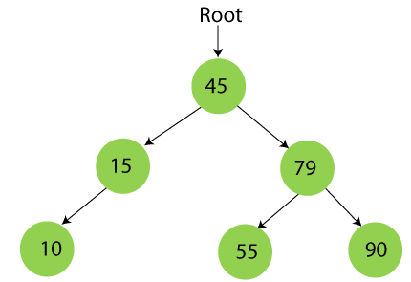
Steps to Create BST
Step 5 - Insert 10.
10 is smaller than 45 and 15, so it will be inserted as a left subtree of 15.
Step 6 - Insert 55.
55 is larger than 45 and smaller than 79, so it will be inserted as the left subtree of 79.

Slide 15
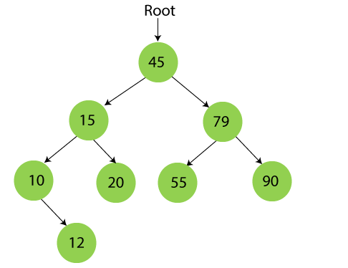
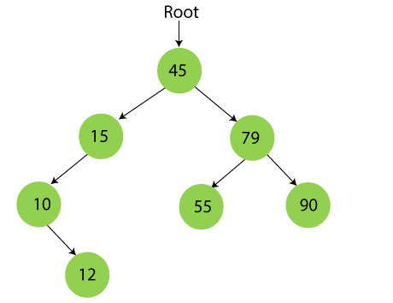
Steps to Create BST
Step 7 - Insert 12.
12 is smaller than 45 and 15 but greater than 10, so it will be inserted as the right subtree of 10.
Step 8 - Insert 20.
20 is smaller than 45 but greater than 15, so it will be inserted as the right subtree of 15.

Slide 16
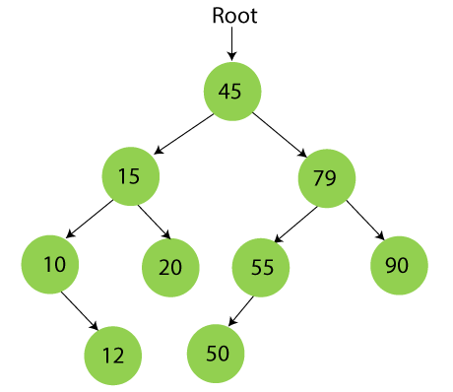
Steps to Create BST
Step 9 - Insert 50.
50 is greater than 45 but smaller than 79 and 55. So, it will be inserted as a left subtree of 55.
Now, the creation of binary search tree is completed.

Slide 17
Search in BST
Searching means to find or locate a specific element or node in a data structure. The steps of searching a node in Binary Search tree are listed as follows -
First, compare the element to be searched with the root element of the tree.
If root is matched with the target element, then return the node's location.
If it is not matched, then check whether the item is less than the root element, if it is smaller than the root element, then move to the left subtree.
If it is larger than the root element, then move to the right subtree.
Repeat the above procedure recursively until the match is found.
If the element is not found or not present in the tree, then return NULL.

Slide 18
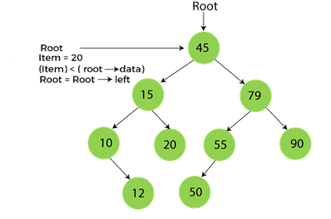
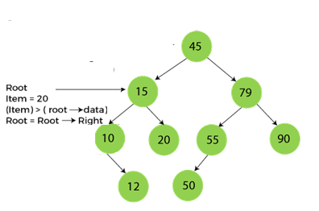
Search in BST
Suppose we have to find node 20 from the below tree.
Step1:
Step2:

Slide 19
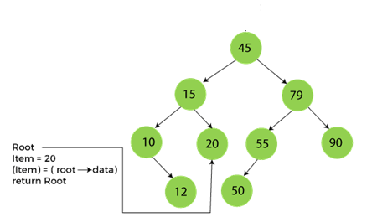
Search in BST
Step3:

Slide 20
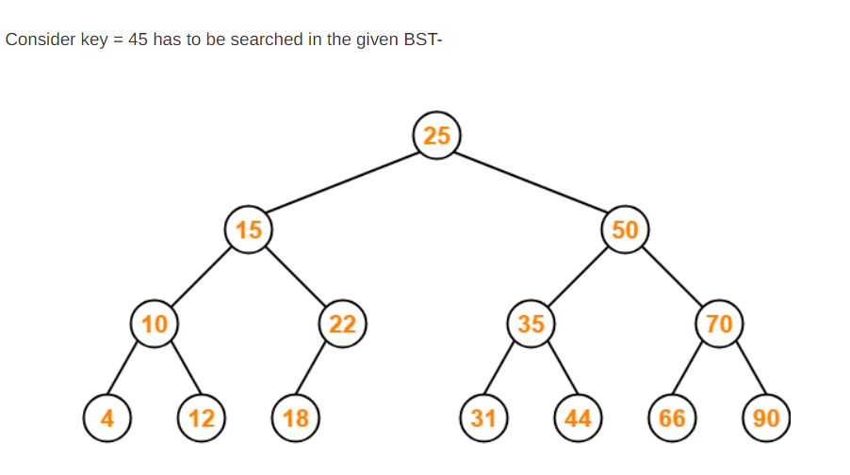
Task (Searching)

